Slide 1
Wait! Before you begin, does this text… If it does NOT then you don’t have the right font installed. Fix that before you start! download the Acid font here, or visit http://toool.us/logo then delete this slide before you begin

Slide 2
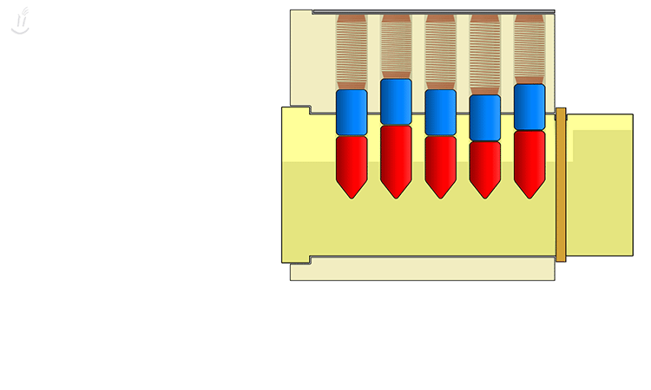
Next Lesson…
3:30
http:// .us .
Lockpicking

Slide 3
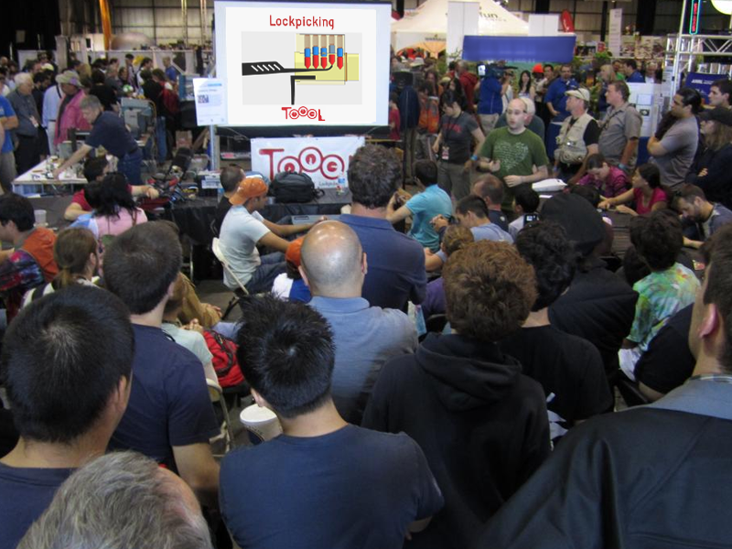
Is Everyone Ready to Learn?

Slide 4
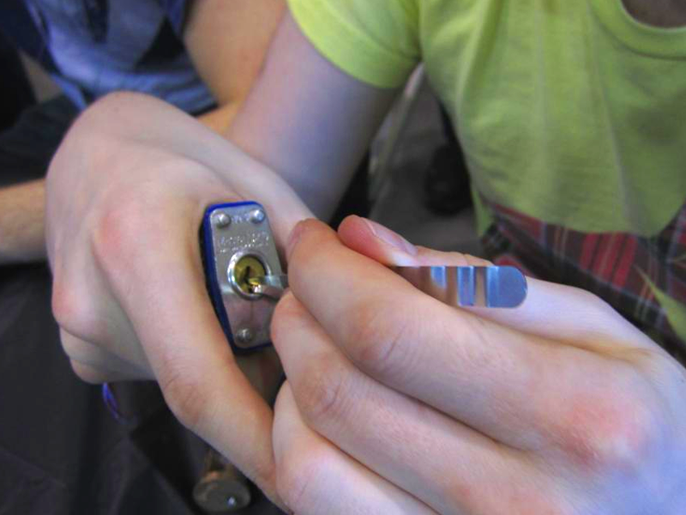
Is Everyone Ready to Learn… About Lockpicking?

Slide 5
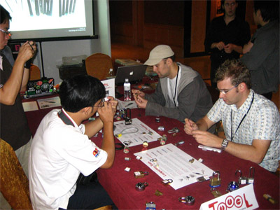
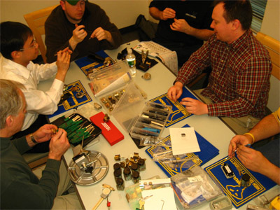
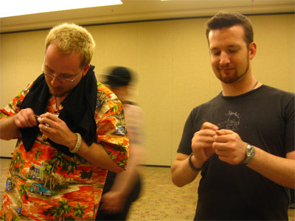
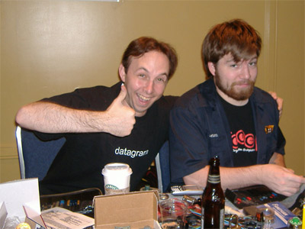
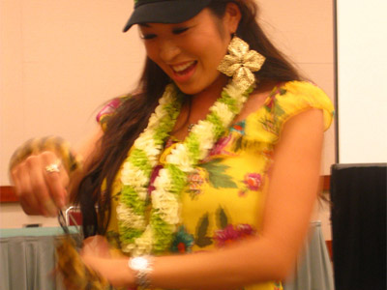
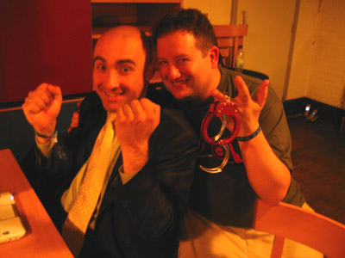
Lockpicking is Fun, Fun, Fun!

Slide 6
First, a word about rules…
Yes, we have rules. ☺
Do not pick someone else’s locks.
Do not pick your locks… if you rely on them.

Slide 7
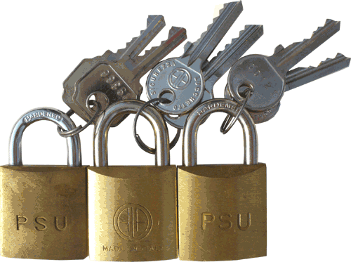
The Three Kinds of Lock-Opening

Slide 8
The Three Kinds of Lock-Opening
Lockpicking – what we do TOOOL provides the knowledge and the means – what spies do TOOOL provides neither knowledge nor means

Slide 9
The Three Kinds of Lock-Opening
Lockpicking – what we do TOOOL provides the knowledge and the means
Quick & Dirty– what spies do TOOOL provides neither knowledge nor means

Slide 10
The Three Kinds of Lock-Opening
Lockpicking – what we do TOOOL provides the knowledge and the means
Quick & Dirty – what criminals do TOOOL provides knowledge. . . but no means
Covert & High-Tech – what spies do TOOOL provides neither knowledge nor means

Slide 11
The Three Kinds of Lock-Opening
Lockpicking – what we do TOOOL provides the knowledge and the means
Quick & Dirty – what criminals do TOOOL provides knowledge. . . but no means
Covert & High-Tech – what spies do TOOOL provides neither knowledge nor means

Slide 12
The Three Kinds of Lock-Opening
Lockpicking – what we do TOOOL provides the knowledge and the means
Quick & Dirty – what criminals do TOOOL provides knowledge. . . but no means
Covert & High-Tech – what spies do TOOOL provides neither knowledge nor means

Slide 13
The Three Kinds of Lock-Opening
Lockpicking – what we do TOOOL provides the knowledge and the means
Quick & Dirty – what criminals do TOOOL provides knowledge. . . but no means
Covert & High-Tech – what spies do TOOOL provides neither knowledge nor means

Slide 14
The Three Kinds of Lock-Opening
Lockpicking – what we do TOOOL provides the knowledge and the means
Quick & Dirty – what criminals do TOOOL provides knowledge. . . but no means
Covert & High-Tech – what spies do TOOOL provides neither knowledge nor means

Slide 15
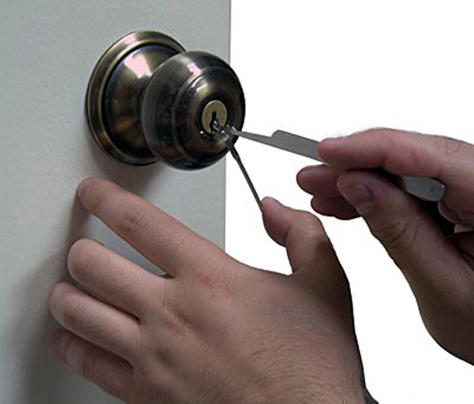
Lockpicking is Easy !

Slide 16
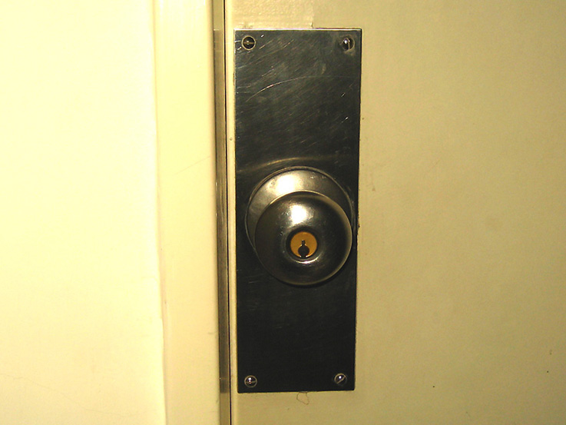
Doorknobs…

Slide 17
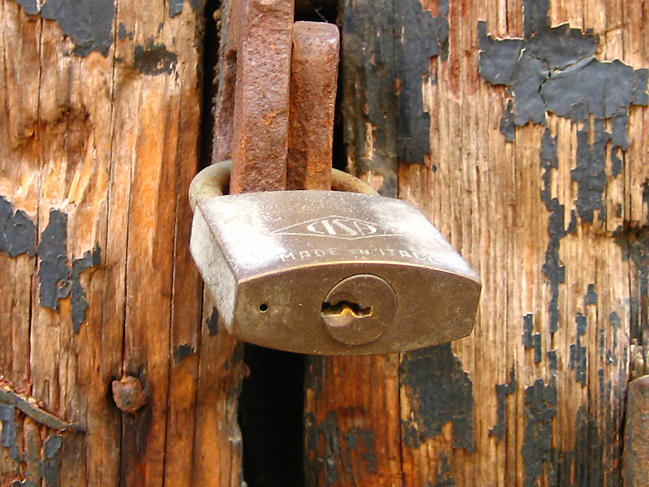
Padlocks…

Slide 18
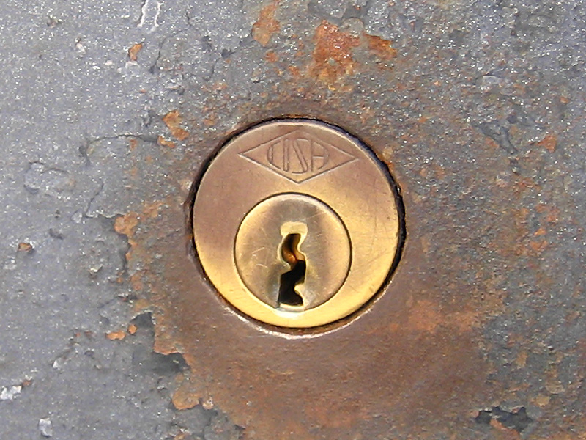
Deadbolts…

Slide 19
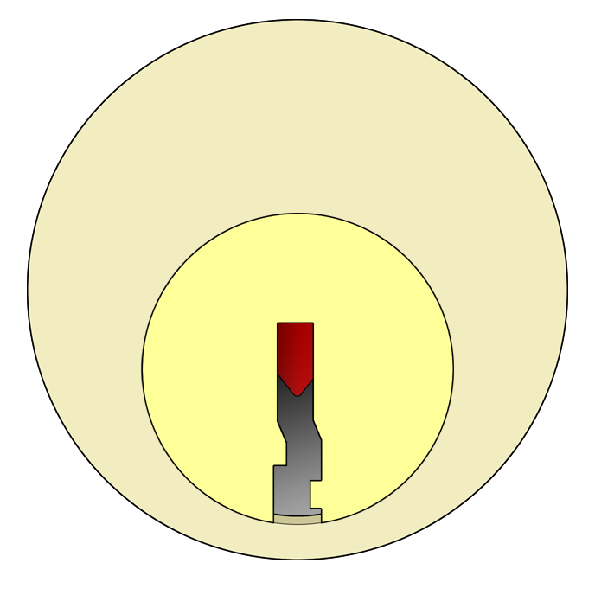
…The Mechanism Itself Is All The Same

Slide 20
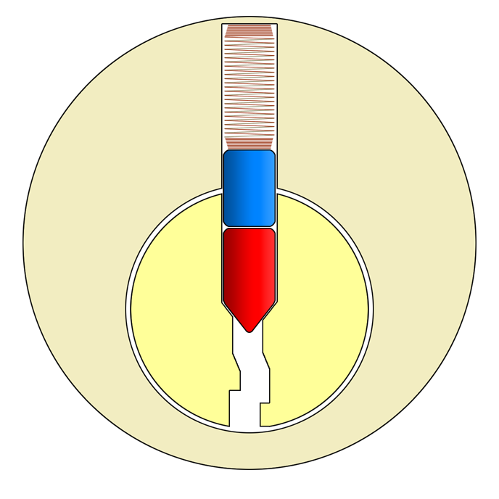
How It Looks Inside

Slide 21
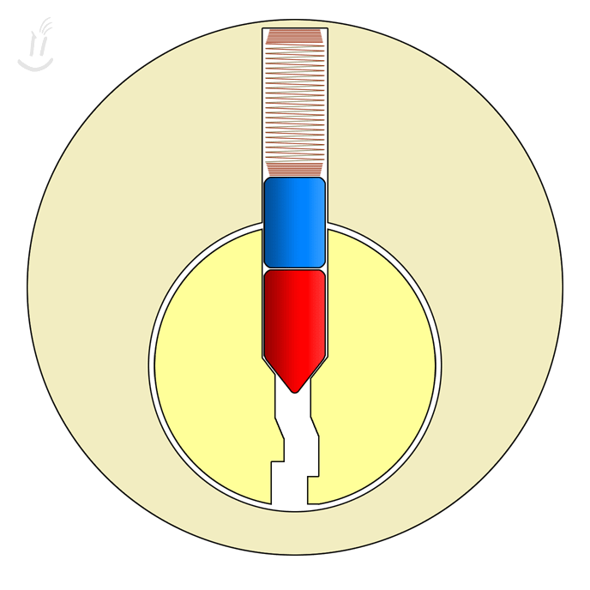
Attempt Without a Key

Slide 22
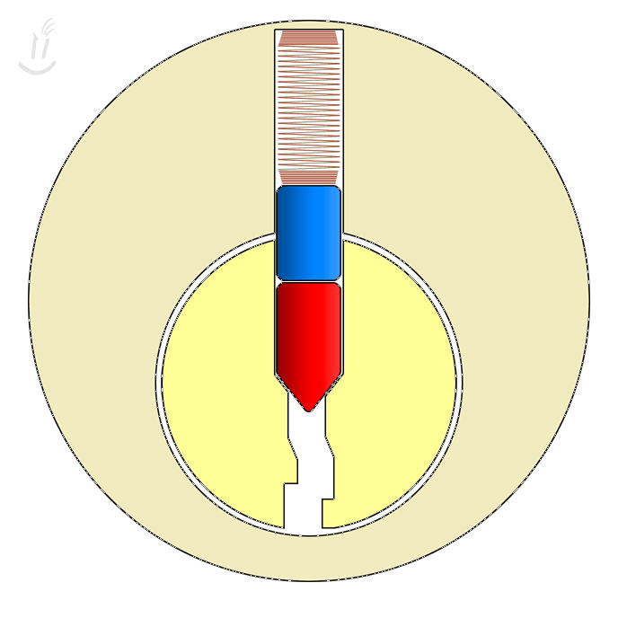
Operating With a Key

Slide 23
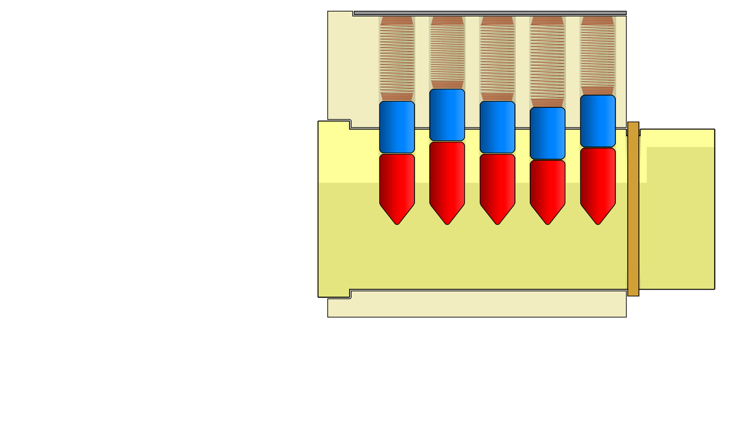
Pin Stacks

Slide 24
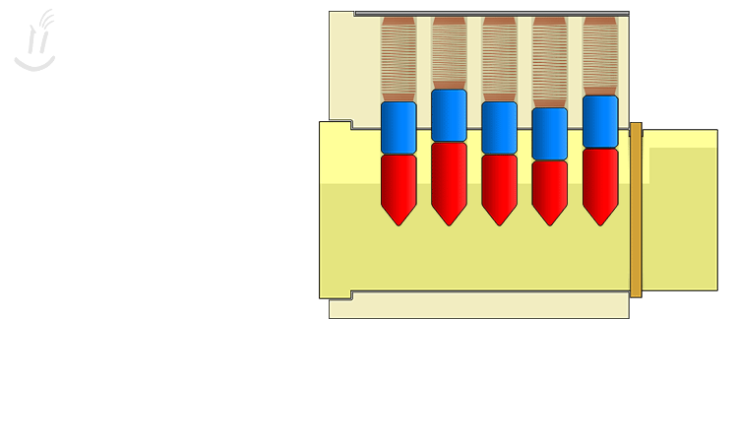
Using a Key

Slide 25
Using Lockpicks

Slide 26
So, Why Is Lockpicking Possible?

Slide 27
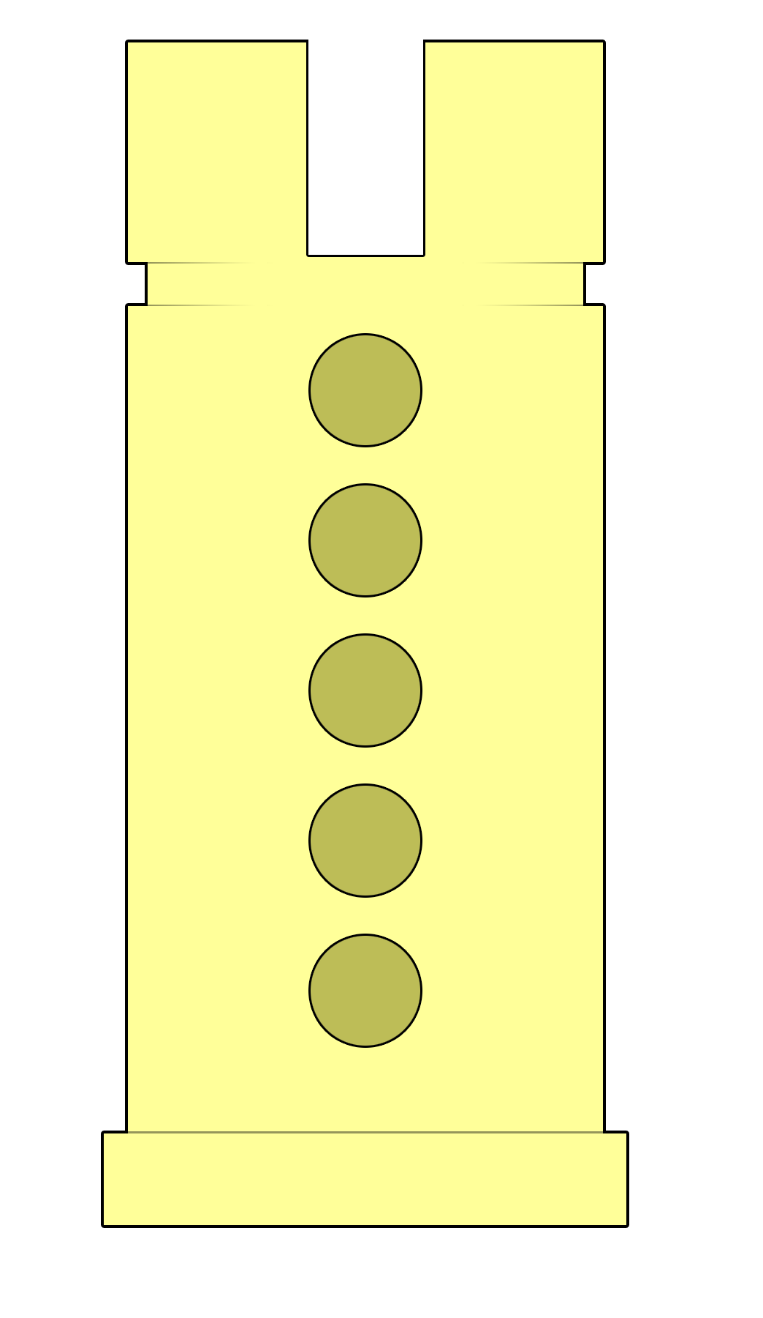
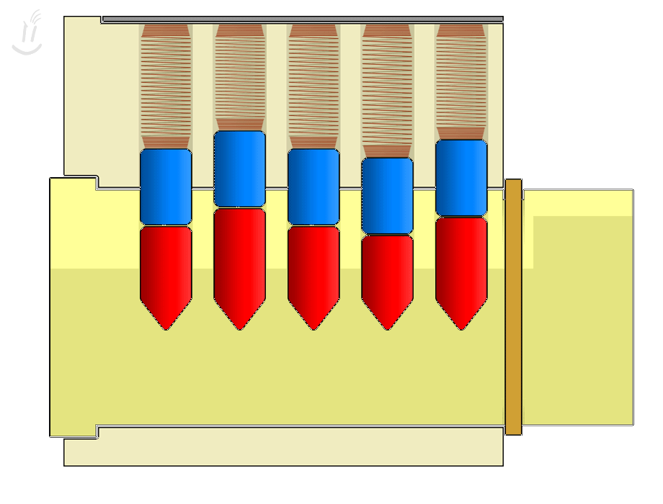
In a Perfect World The Parts Would Function Like This…

Slide 28
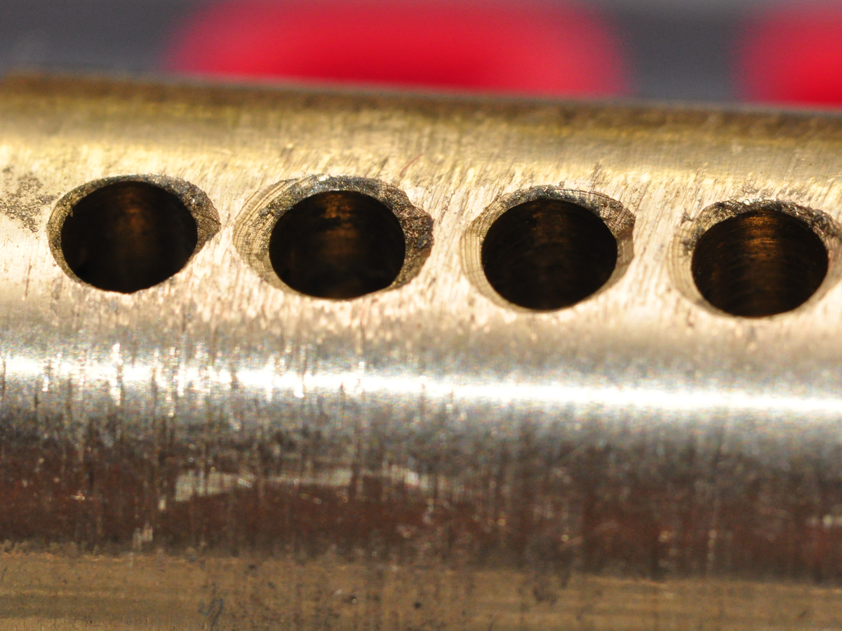
Parts In the Real World Look Like This…

Slide 29
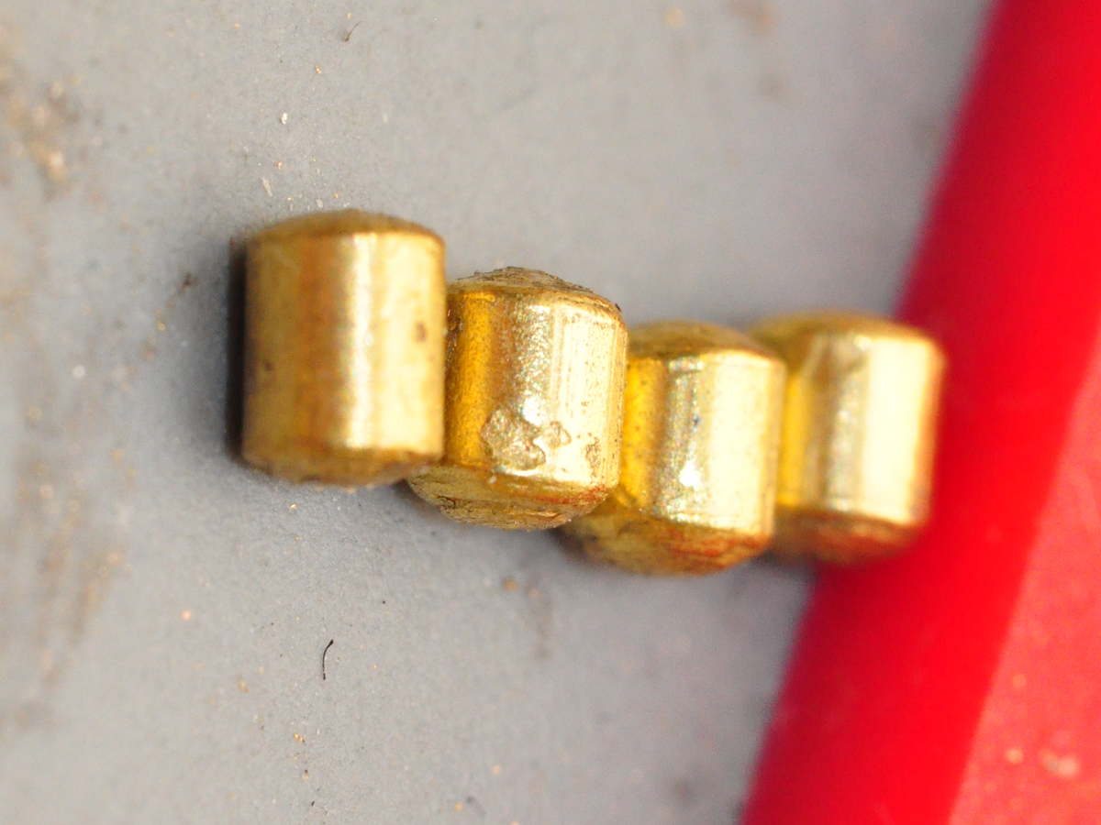
Parts In the Real World Look Like This…

Slide 30
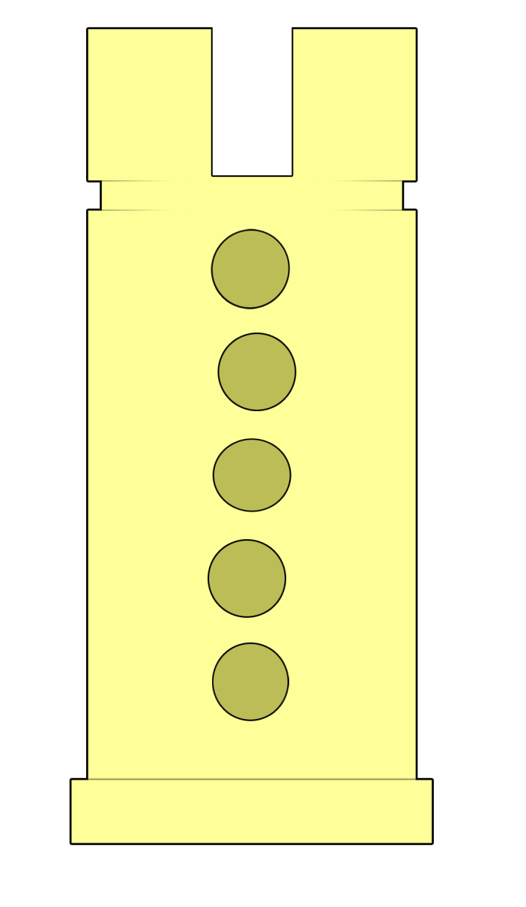
Parts In the Real World Function Like This…

Slide 31
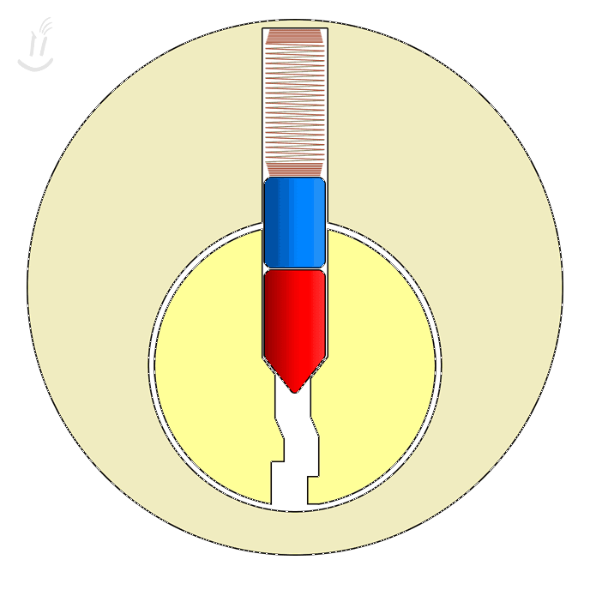
“Setting” a Binding Pin by Turning & Lifting the Stack

Slide 32
Setting Multiple Pins

Slide 33
Take Caution to Avoid Over-Lifting

Slide 34
Other Tools One Uses

Slide 35
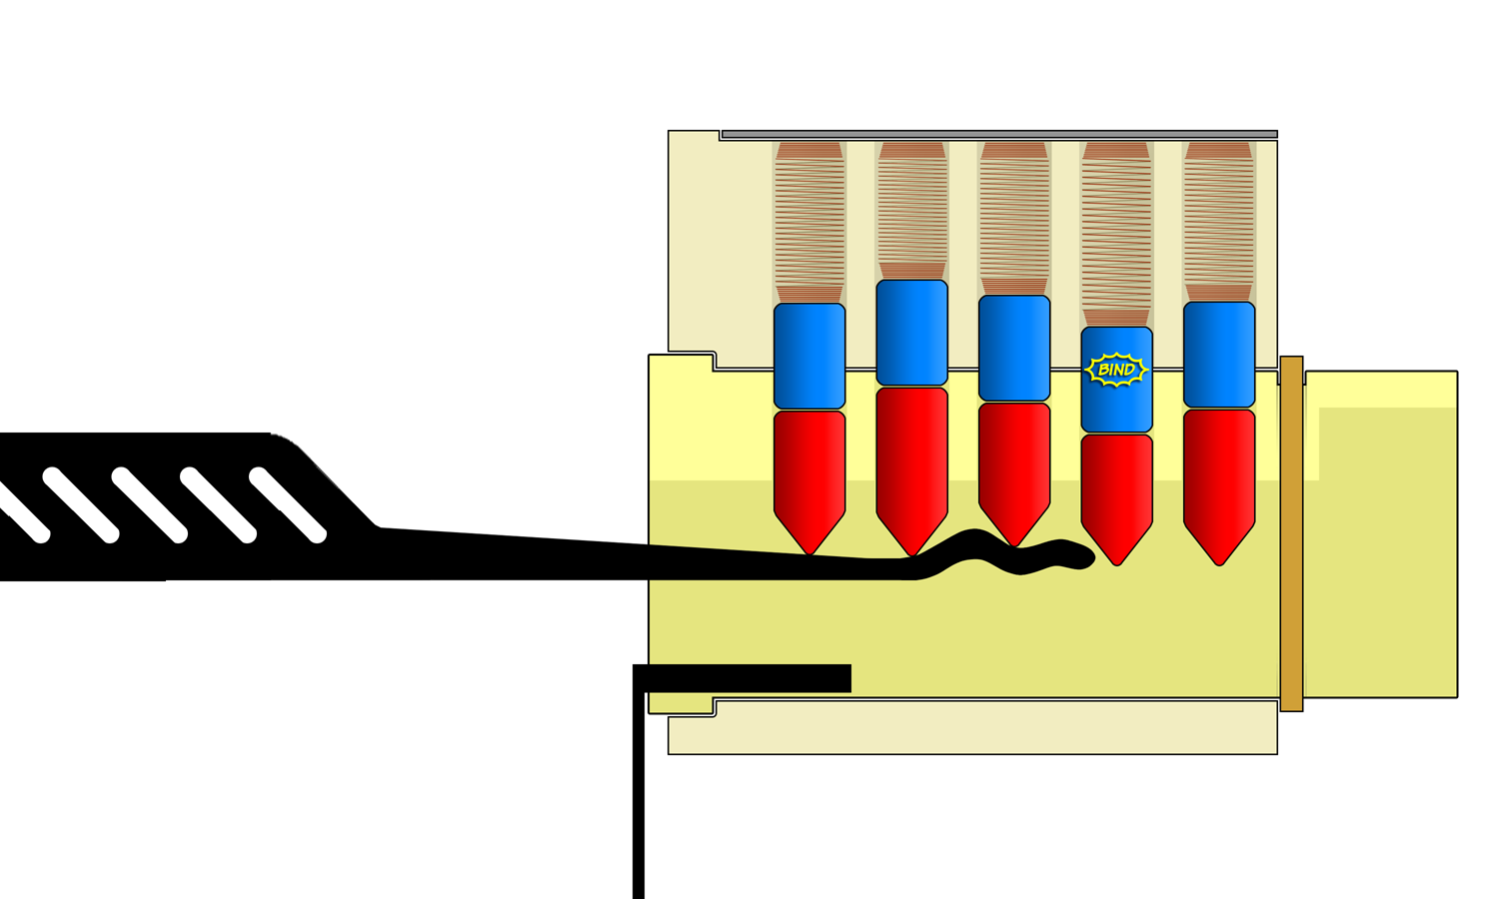
Raking Tools

Slide 36
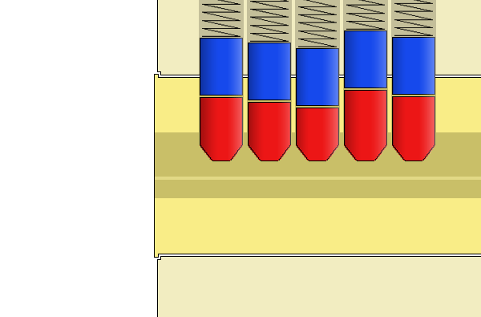
Raking Tools

Slide 37
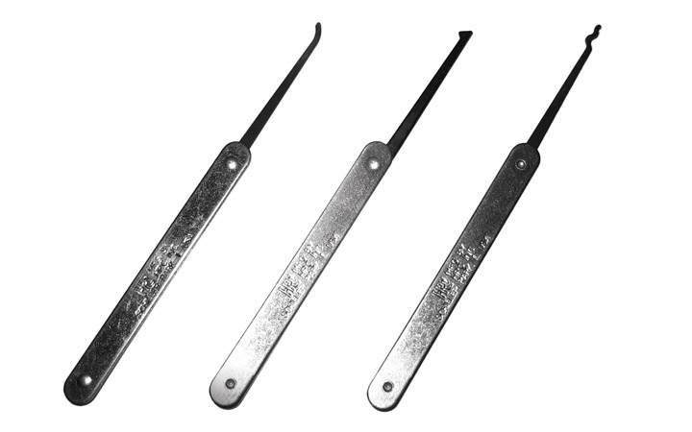
The Half-Diamond

Slide 38
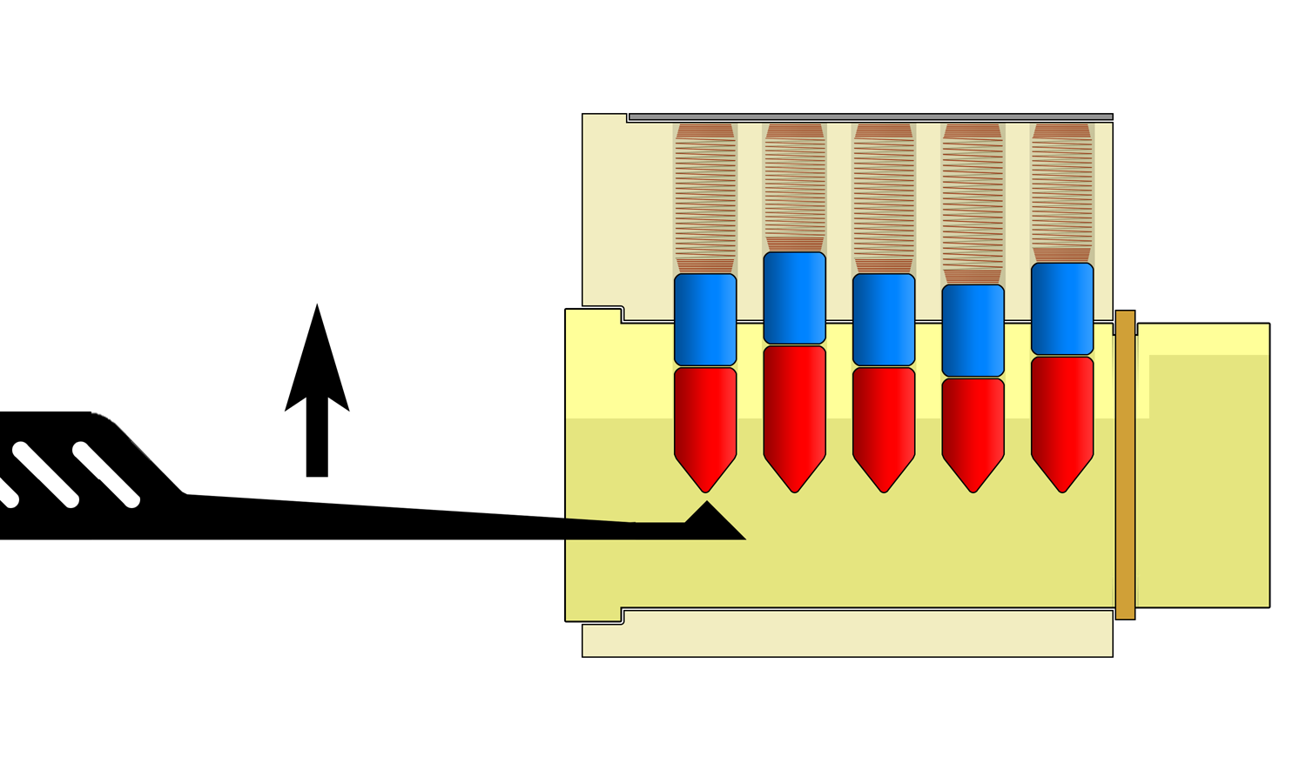
Lifting with a Half-Diamond

Slide 39
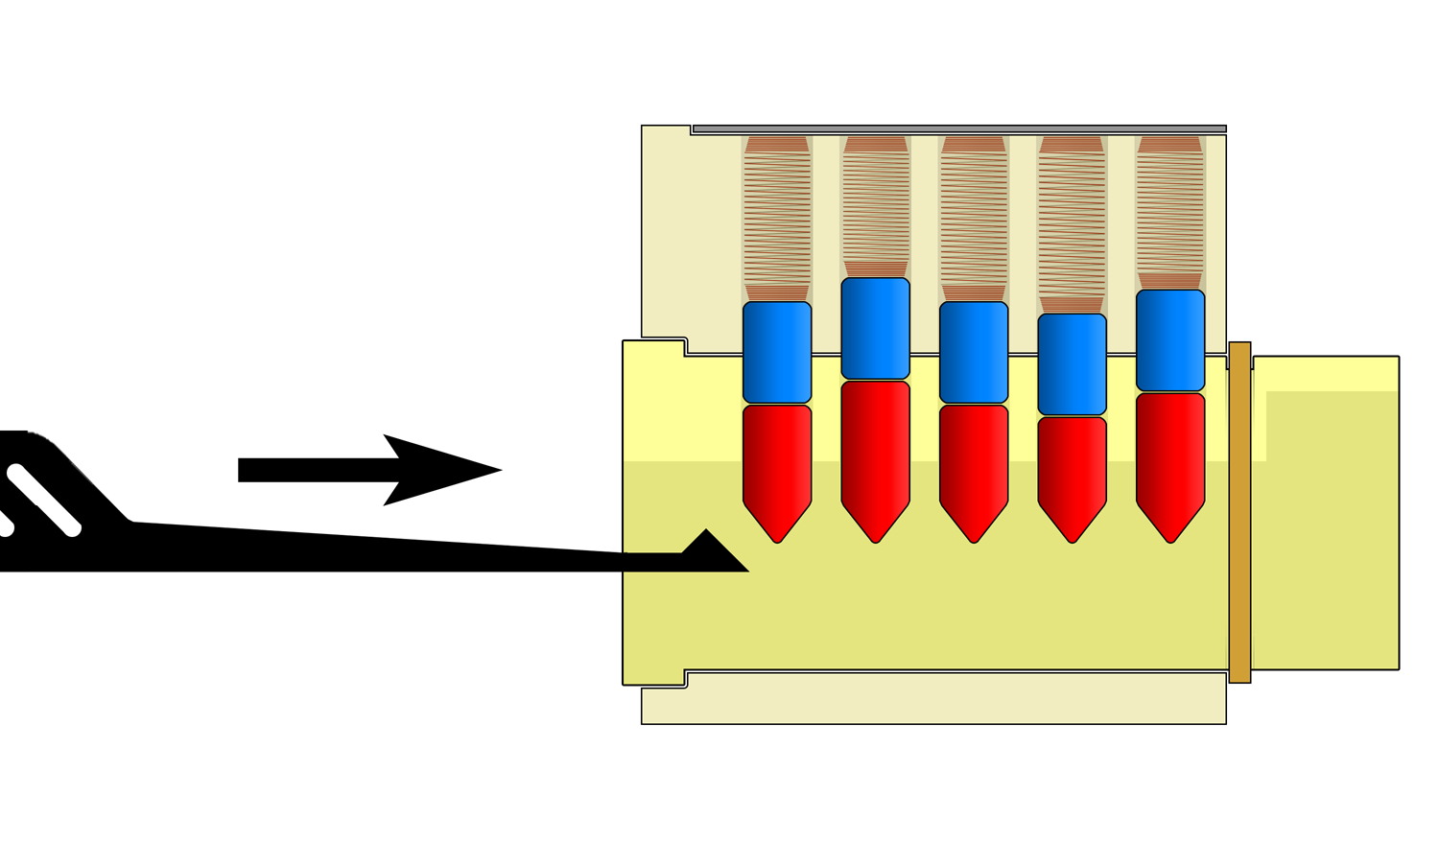
Raking / Shoveling with a Half-Diamond

Slide 40
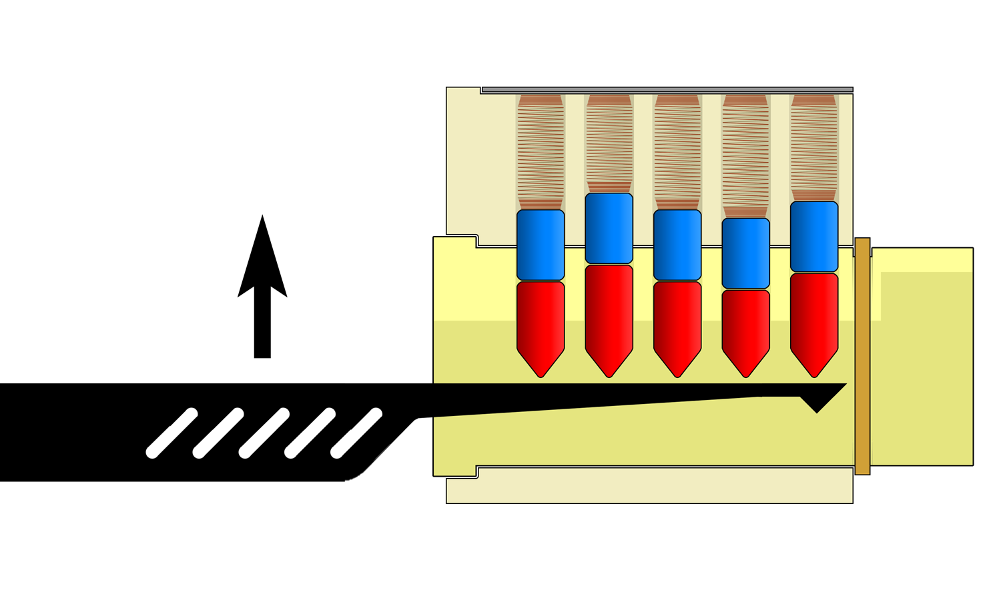
Using the Flat Underside

Slide 41
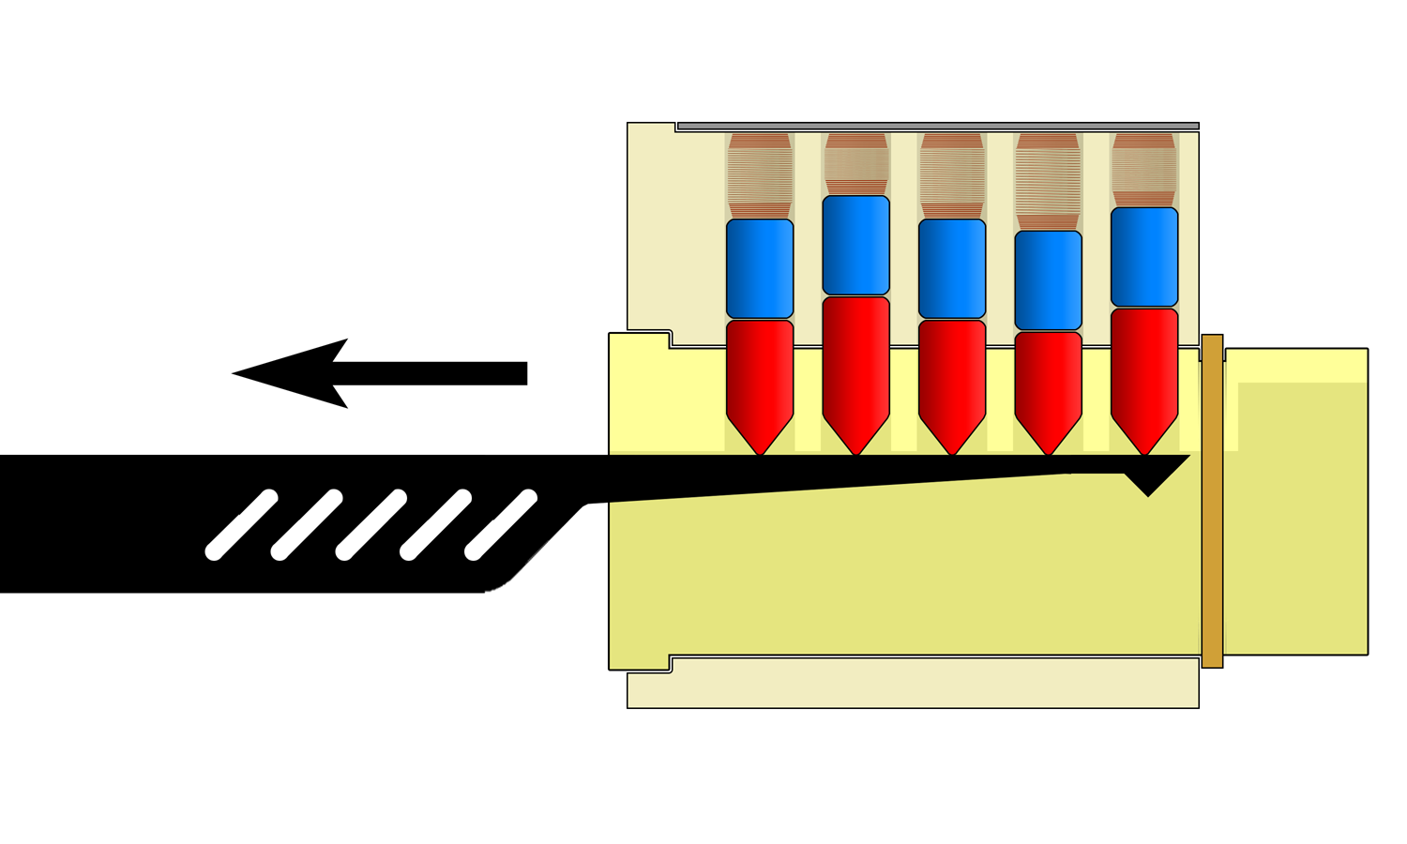
Counting Pin Stacks

Slide 42
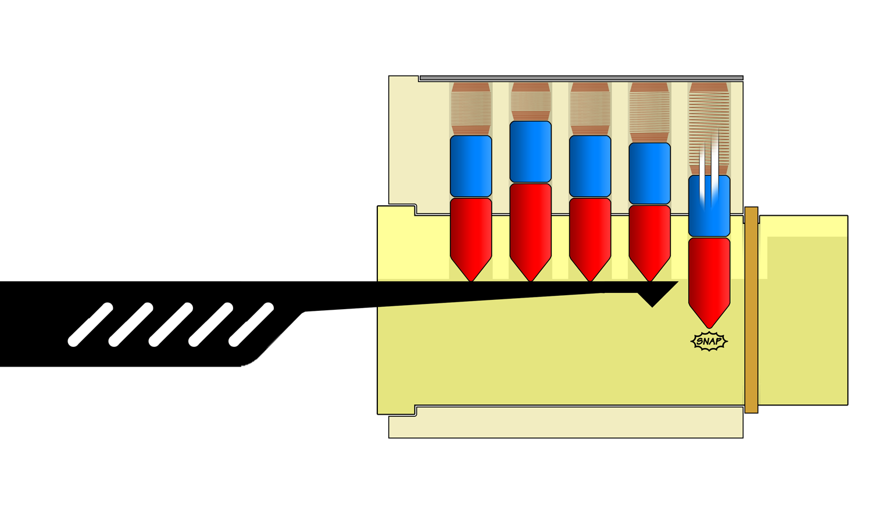
Counting Pin Stacks

Slide 43
Turning the Plug

Slide 44
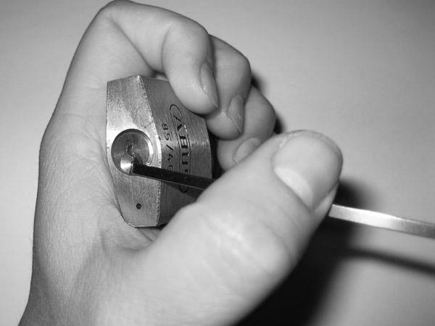
Bad Turning Tool Usage (Pulling)

Slide 45
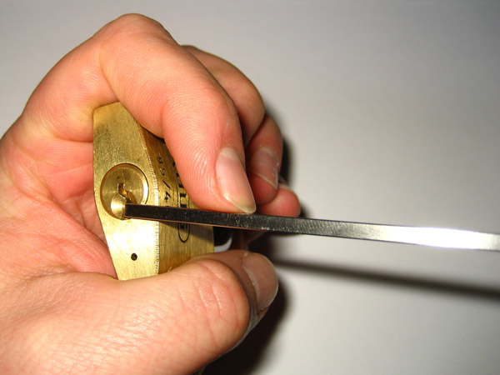
Better Turning Tool Usage (Pushing)

Slide 46
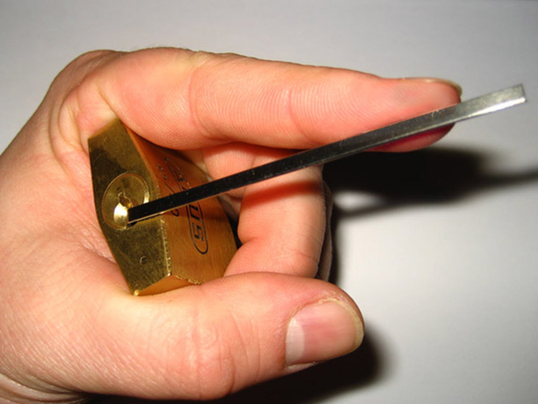
Best Turning Tool Usage (Pushing Out at Tip)

Slide 47
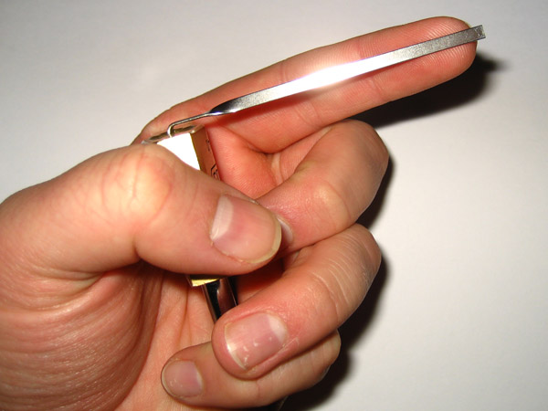
Good Turing Tool Pressure

Slide 48
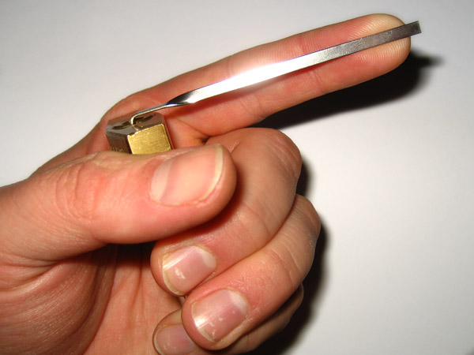
Too Much Turing Tool Pressure!

Slide 49
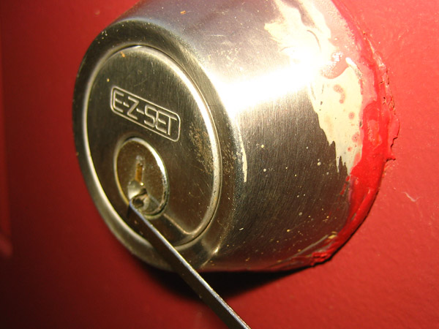
Typical Turning Tool Position: “Edge of the Plug”

Slide 50
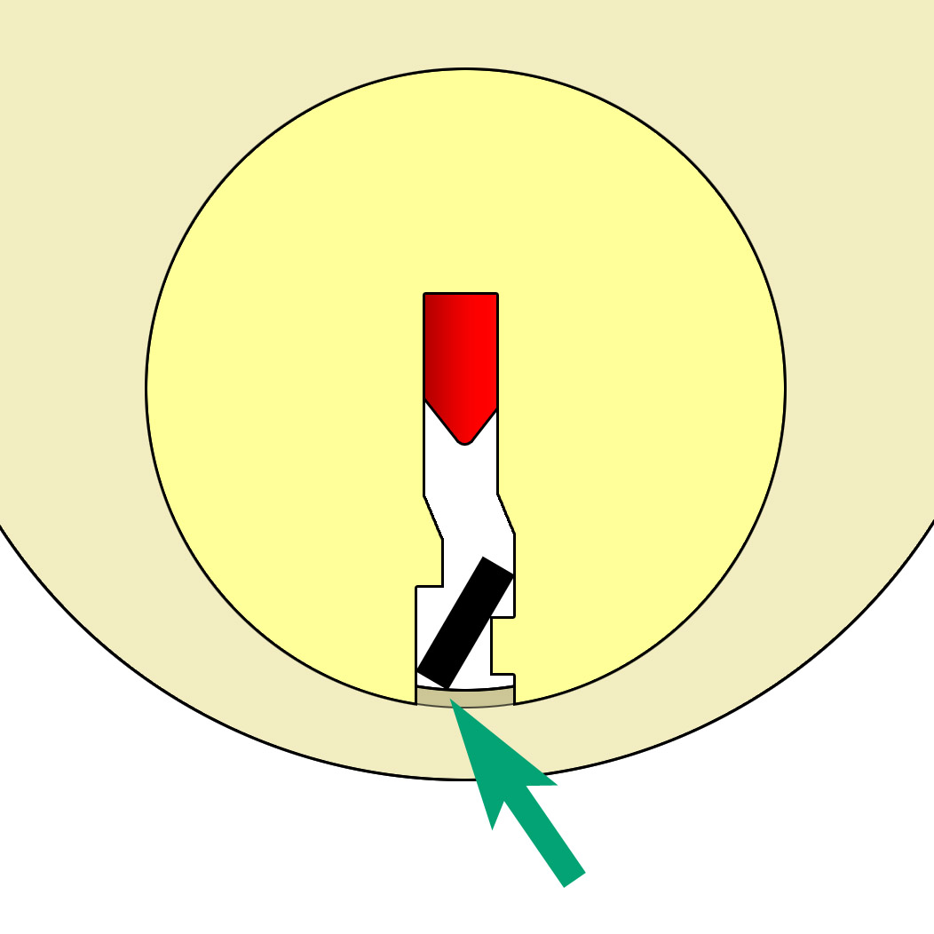
Careful To Not Cause Extra Friction

Slide 51
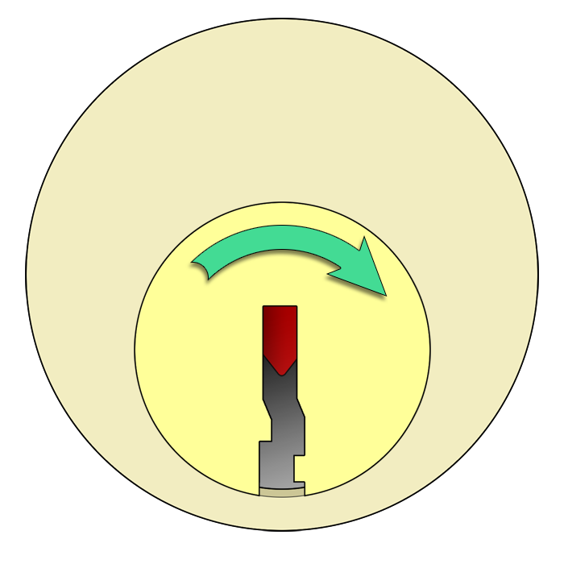
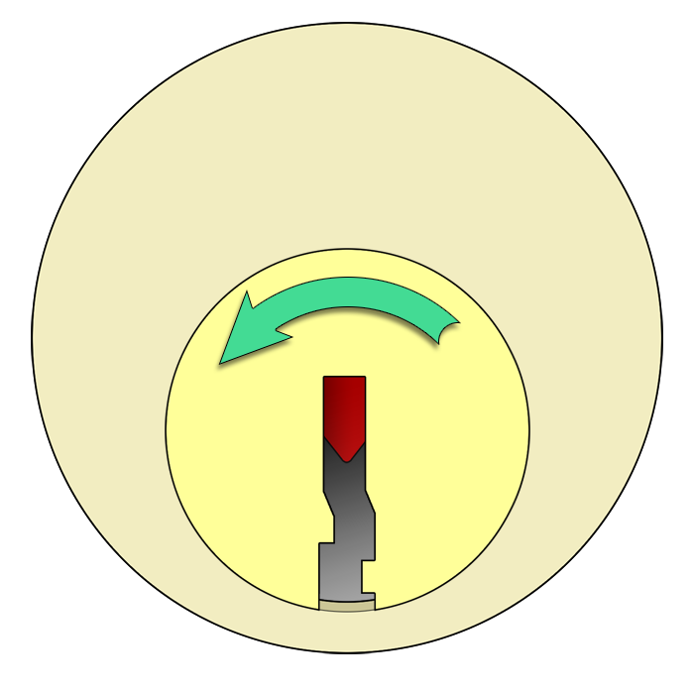
Which Direction Should You Turn?

Slide 52
Which Direction Should You Turn?
☺
Either Direction Will Work On Our Locks

Slide 53
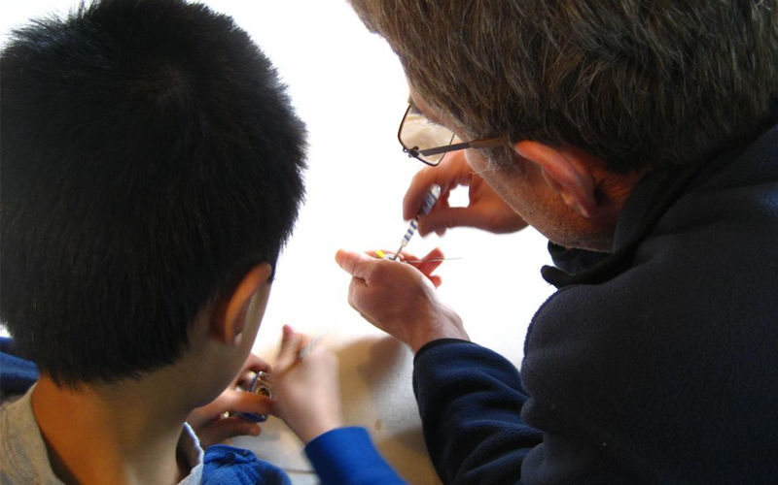
Who Wants To Try?

Slide 54
Our Practice Locks

Slide 55
Our Practice Locks
The silver part is the front face…
… the brass ring is the rear!

Slide 56
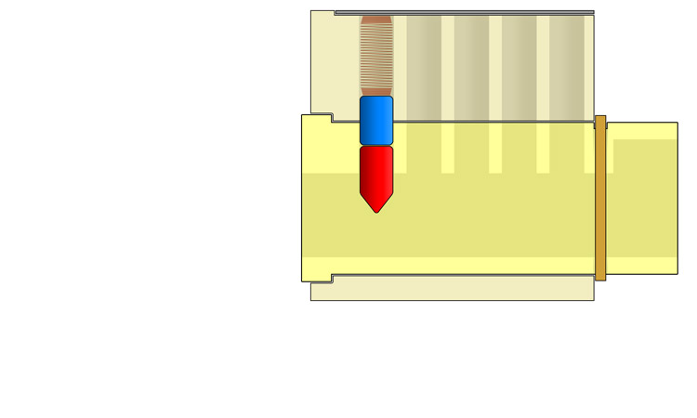
Starter Exercises

Slide 57
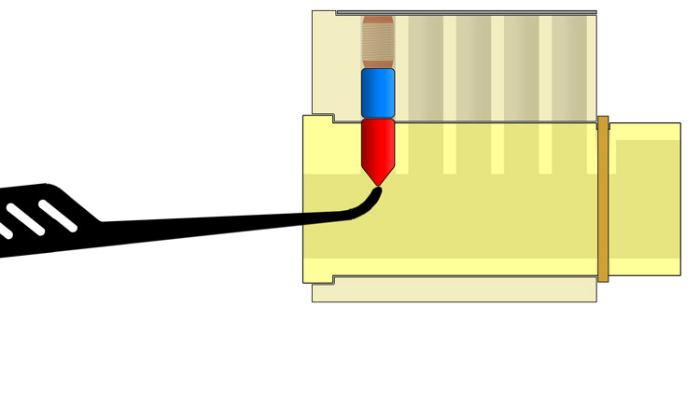
Starter Exercises

Slide 58
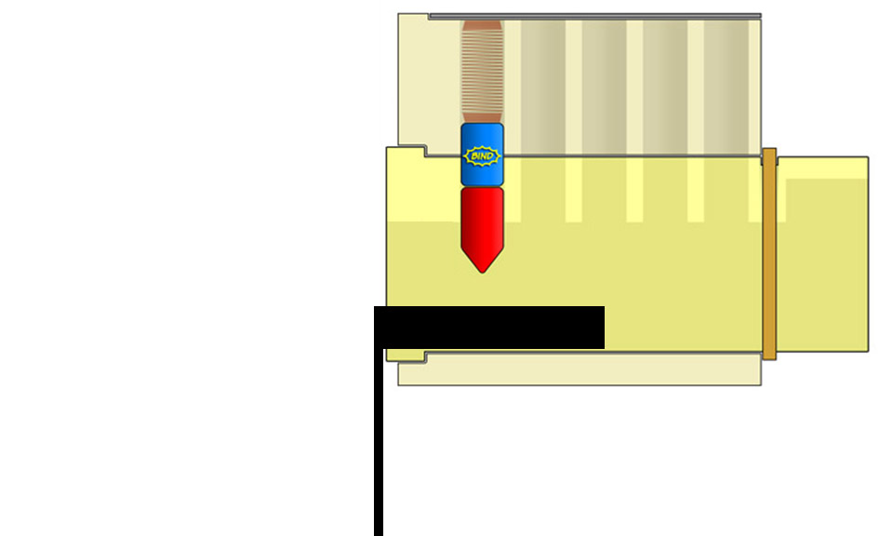
Starter Exercises

Slide 59
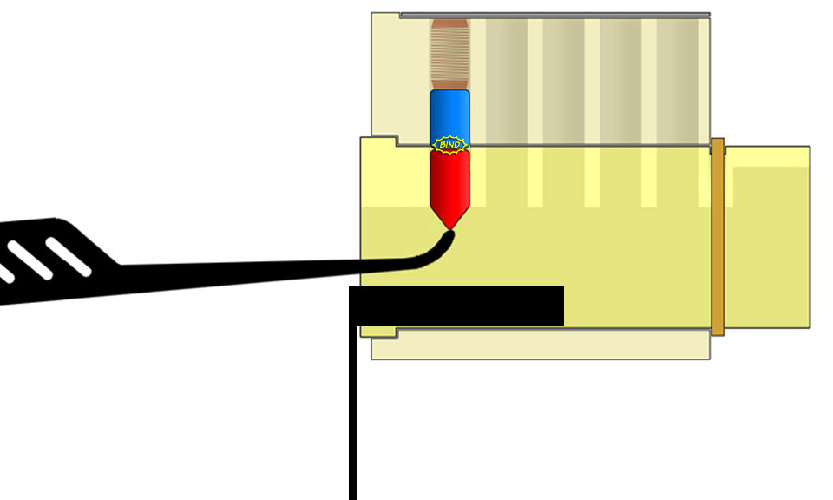
Starter Exercises

Slide 60
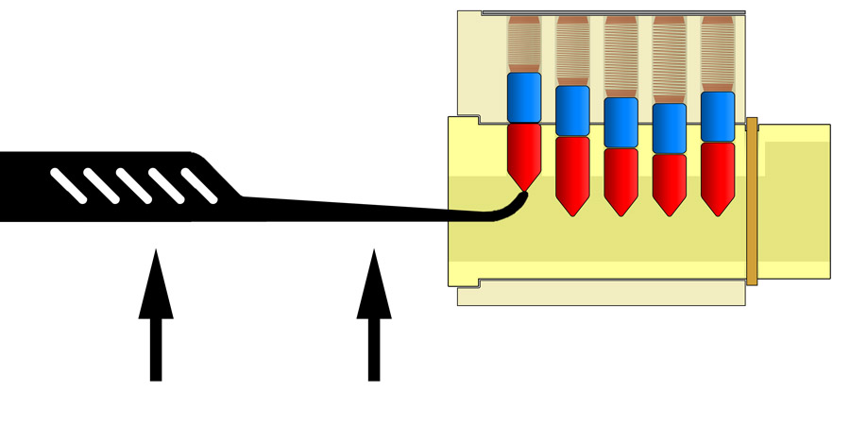
Direct Lifting

Slide 61
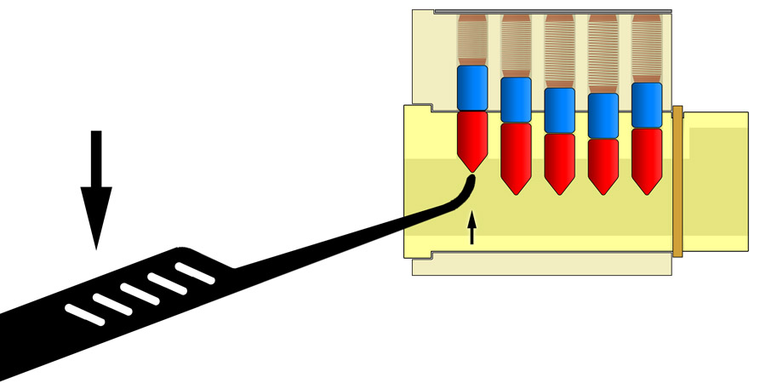
Rocking Lifting

Slide 62
Or Try Raking, Etc.

Slide 63
The Two Most Important Things…
RELAX

Slide 64
The Two Most Important Things…
OPEN!

Slide 65
Thank You Very Much!
http://toool.us
info@toool.us
This presentation is CopyLeft by Deviant Ollam. You are free to reuse any or all of this material as long as it is attributed and freedom for other s to do the same is maintained.

Slide 66
Come Join Us!
This presentation is CopyLeft by Deviant Ollam. You are free to reuse any or all of this material as long as it is attributed and freedom for other s to do the same is maintained.

Slide 67
Thank You Very Much!
http://toool.us
info@toool.us
This presentation is CopyLeft by Deviant Ollam. You are free to reuse any or all of this material as long as it is attributed and freedom for other s to do the same is maintained.

